Slide 1
Patches
Matthew McAvoy – in Partnership with Blur-de-blur team
2020.12.10

Slide 2
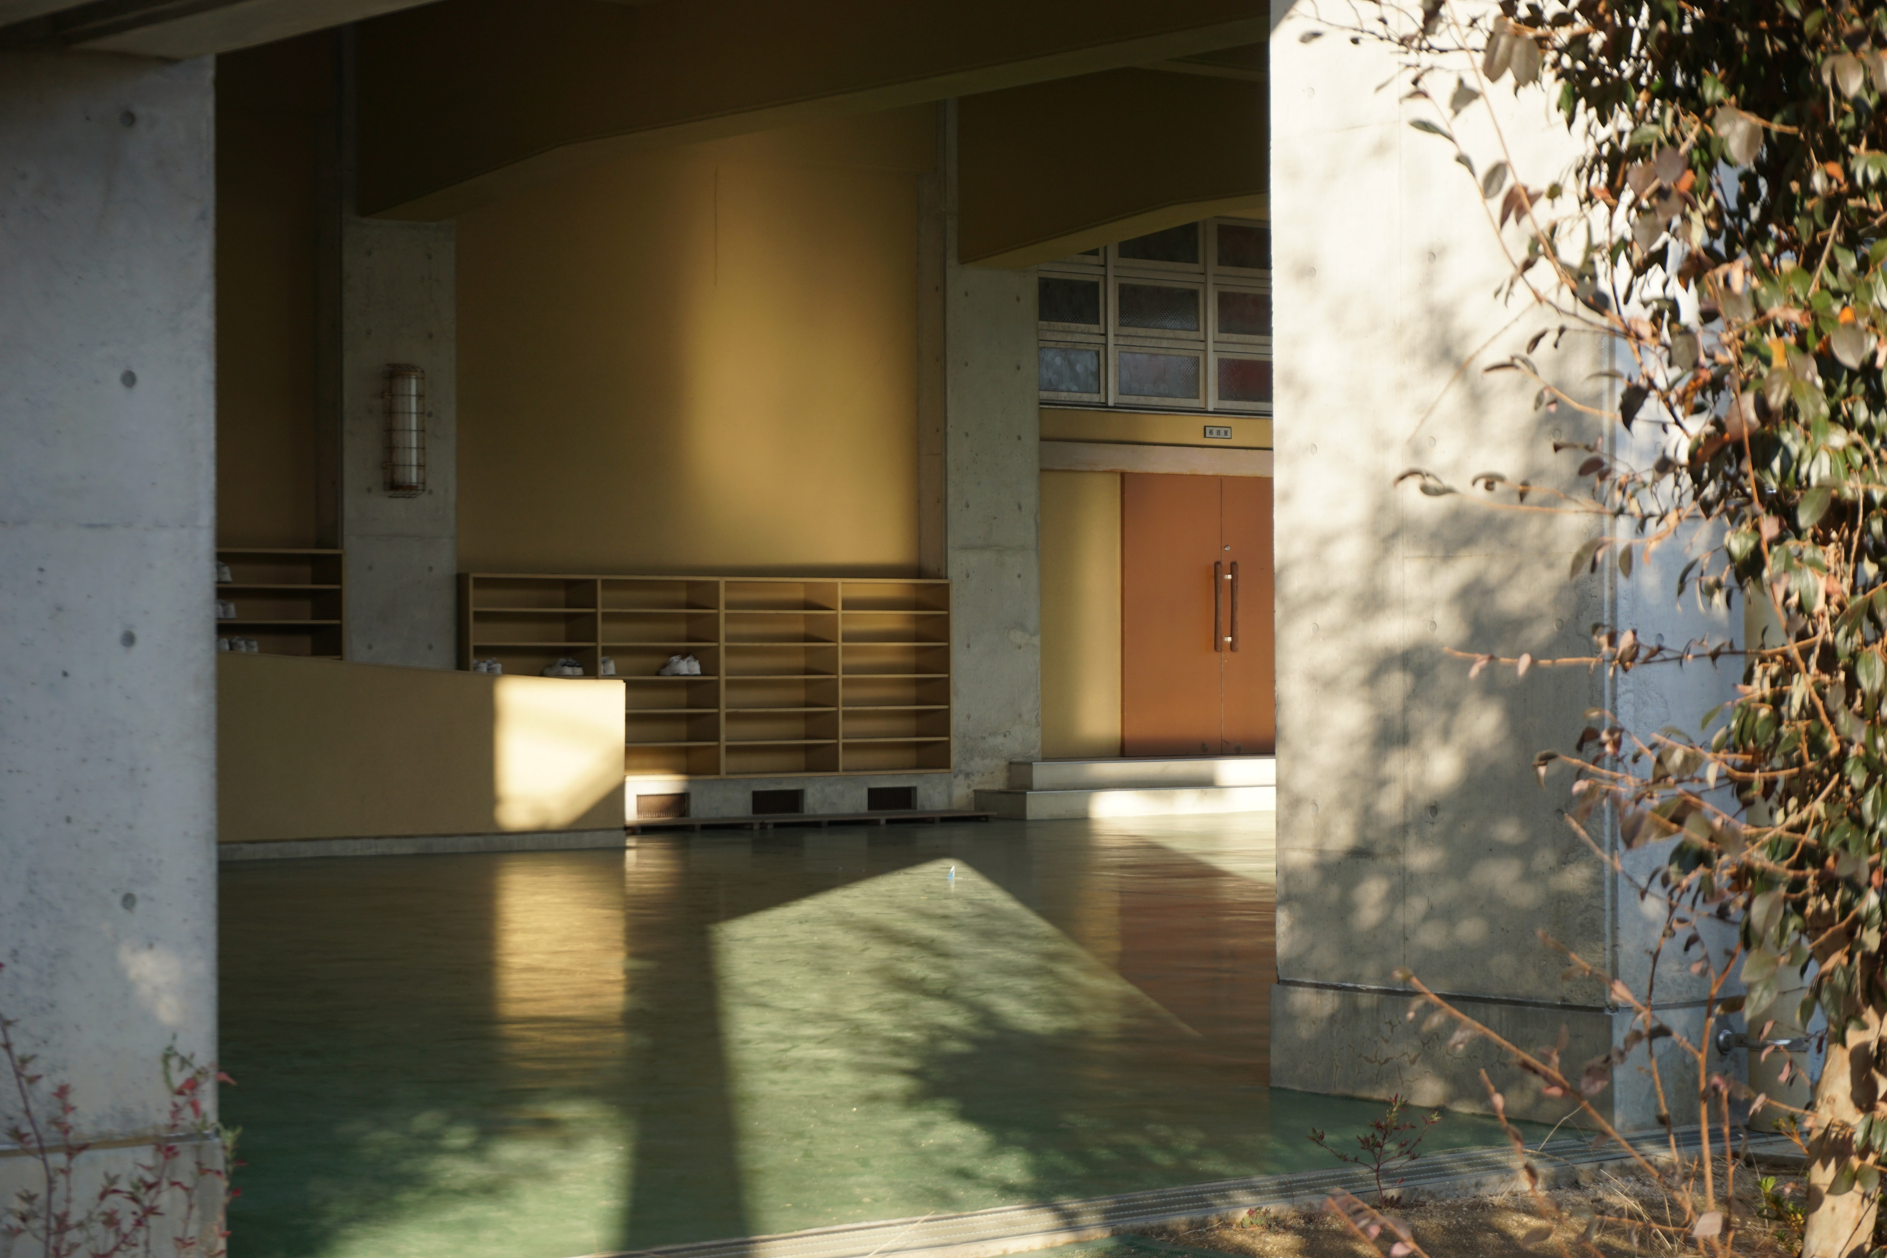

Slide 3


Slide 4
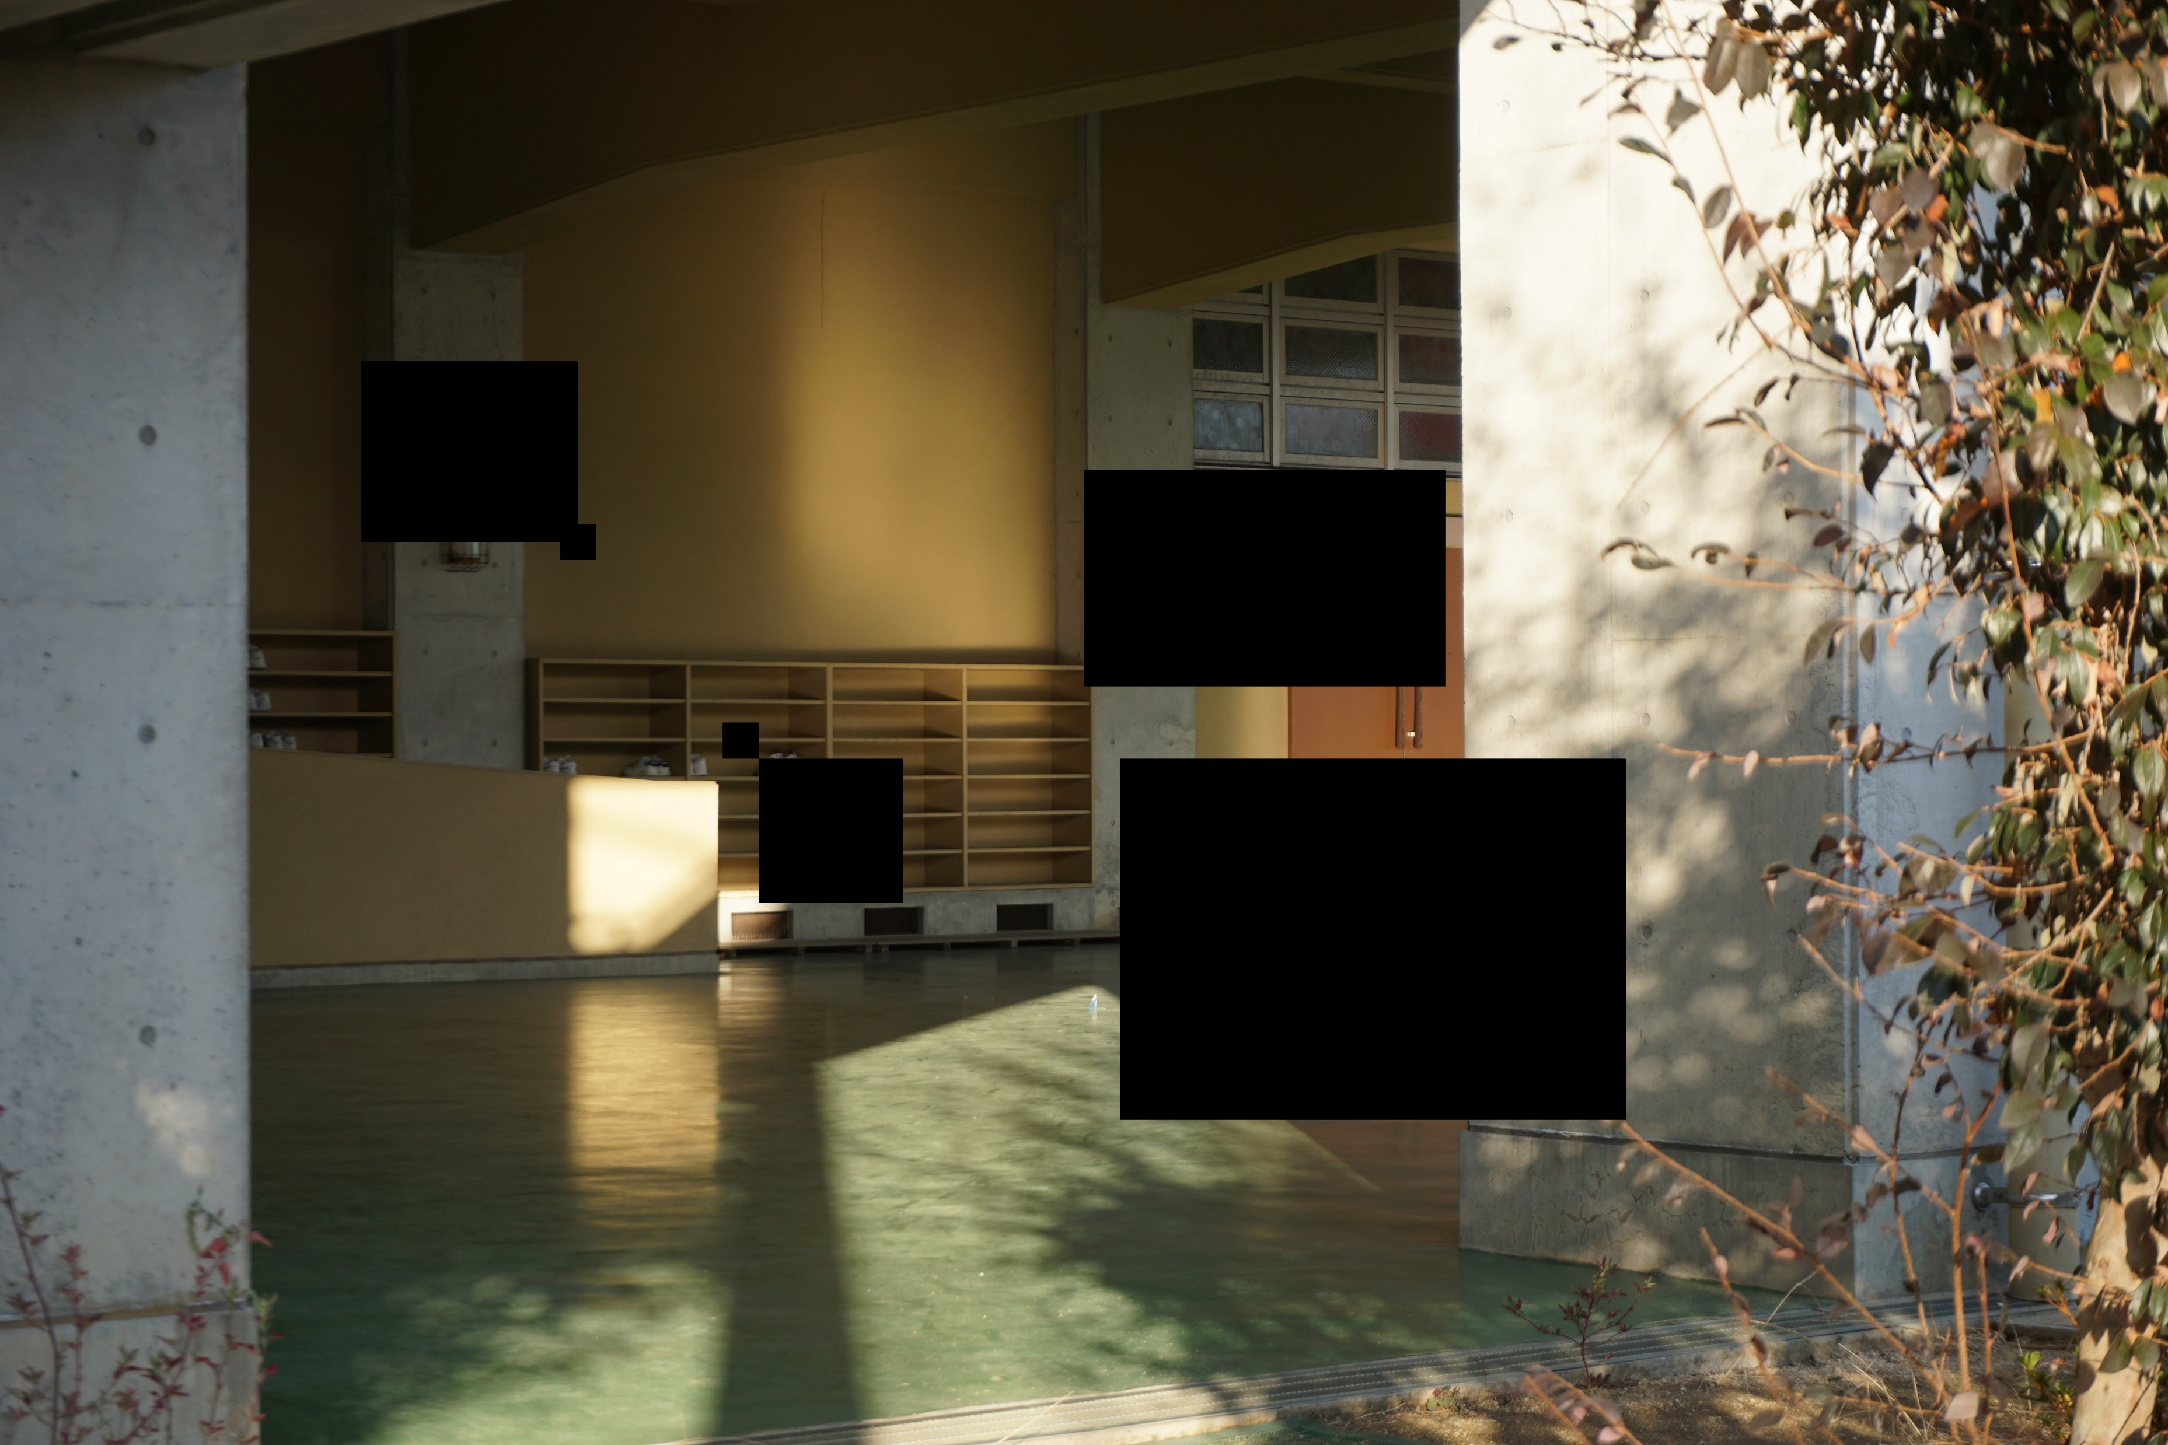

Slide 5


Slide 6


Slide 7
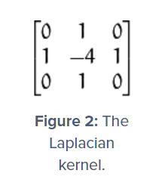
Classify blurred
A discrete laplacian is the sum of the second derivatives in a 3 by 3 convolution for each pixel
Tells us about edges and motion in image
Many edges, higher variance -> classify not blurry
Fewer edges, lower variance -> classify blurry
Hyperparameter on threshold constant – chose normalized variance
Hand-drawn rectangles didn’t fair very well; 5/9 correctly classified (errors in both positive and negative labels)
Source: https://www.pyimagesearch.com/2015/09/07/blur-detection-with-opencv/

Slide 8
Examples
Cover: 100 x 100
Image: 4000 x 6000

Slide 9
Lower bound - 2400

Slide 10
Upper bound – 23,010,000

Slide 11
Covering bound – ?

Slide 12
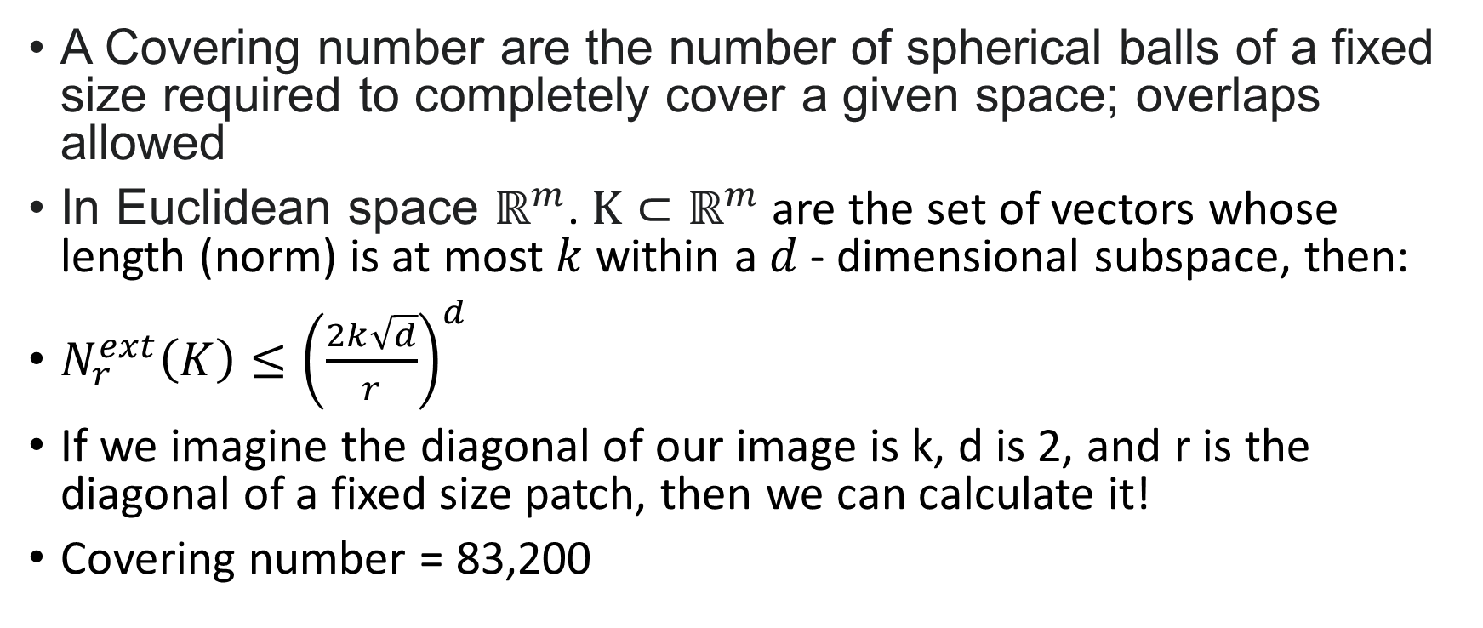
Covering Number Theorem
A Covering number are the number of spherical balls of a fixed size required to completely cover a given space; overlaps allowed
In Euclidean space $ℝ^{m}$. $K⊂ℝ^{m}$ are the set of vectors whose length (norm) is at most $k$ within a $d$- dimensional subspace, then:
$N_{r}^{ext}\left(K\right)≤{\left(\frac{2k\sqrt{d}}{r}\right)}^{d}$
If we imagine the diagonal of our image is k, d is 2, and r is the diagonal of a fixed size patch, then we can calculate it!
Covering number = 83,200

Slide 13
Post process
Best way to cover?

Slide 14


Slide 15
Summary
Blur region with fourier transform
Classify blur using variance in laplacian
Lower bound: 2,400 (4 mins)
Covering bound: 83,200 (1.5 hrs)
Upper bound: 23,010,000 (~42 days)

